Slide 1
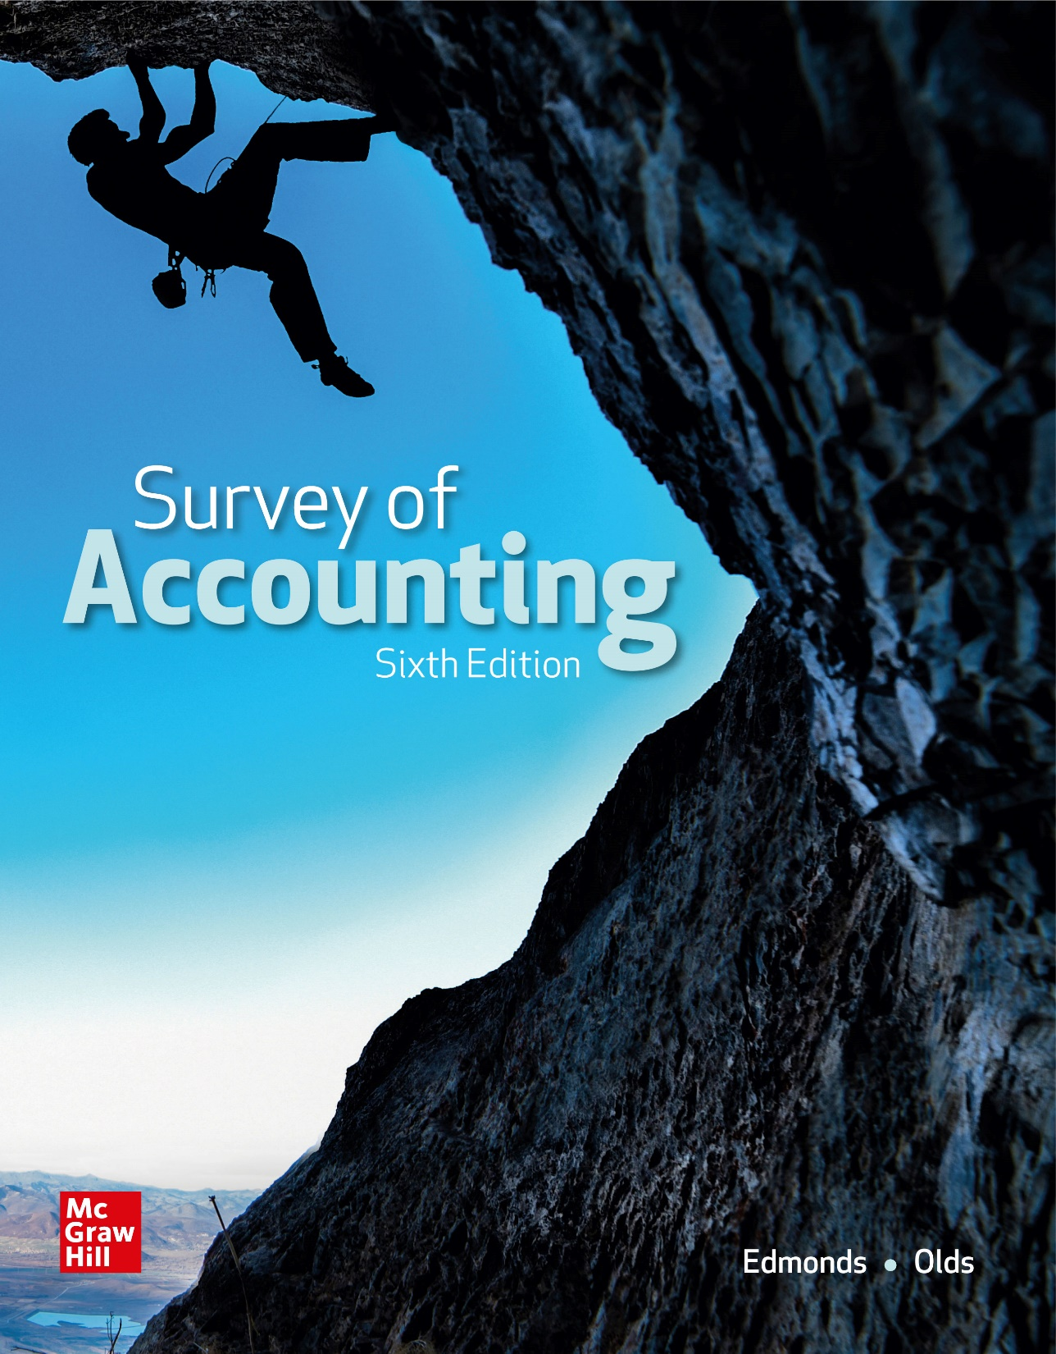
Chapter 2
Accounting for Accruals and Deferrals

Slide 2
Accrual Accounting
Accrual
Deferral
A revenue or expense event that is recognized before cash is exchanged
A revenue or expense event that is recognized after cash has been exchanged

Slide 3
LO 2-1:
Show how receivables affect financial statements.

Slide 4
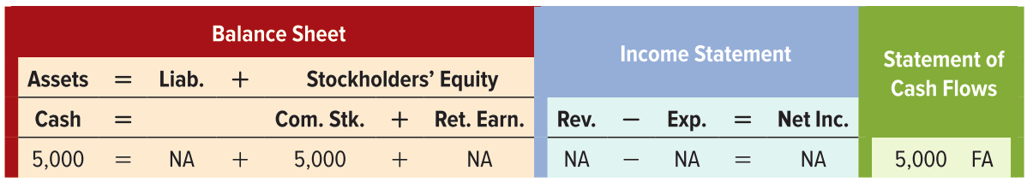
Event 1
Cato Consultants was started on January 1, Year 1, when it acquired $5,000 cash by issuing common stock.
Asset Source Transaction

Slide 5
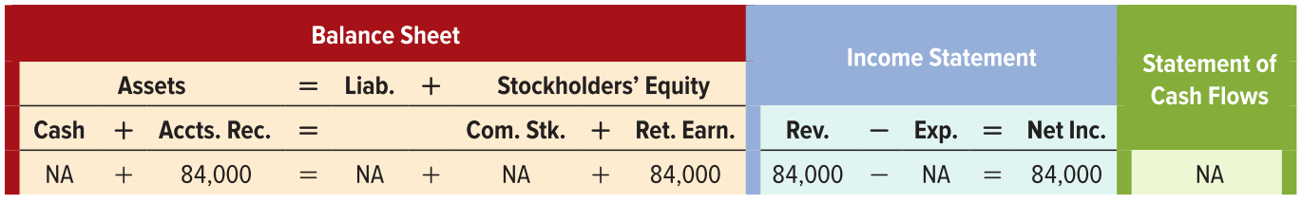
Event 2
During Year 1, Cato Consultants provided $84,000 of consulting services to its clients but has not yet collected any cash
Asset Source Transaction

Slide 6
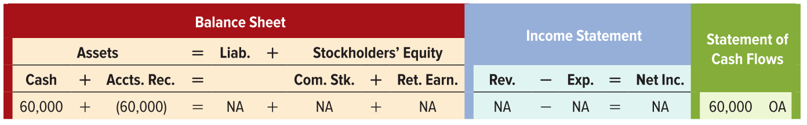
Event 3
Cato collected $60,000 cash from customers in partial settlement of its accounts receivable.
Asset Exchange Transaction

Slide 7
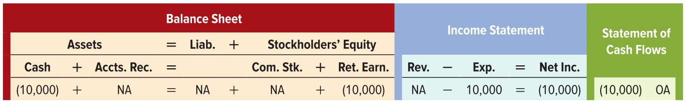
Event 4
Cato paid the instructor $10,000 for teaching training courses (salary expense).
Asset Use Transaction

Slide 8
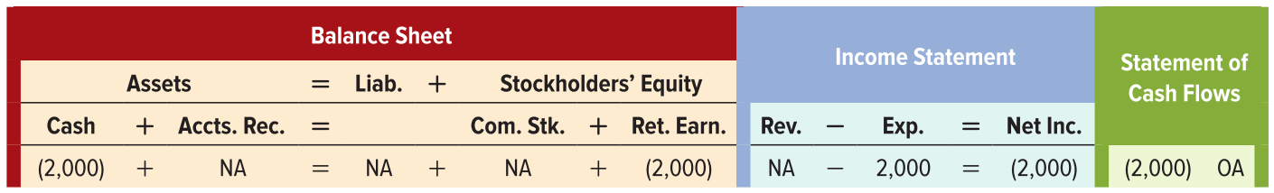
Event 5
Cato paid $2,000 cash for advertising costs. The advertisements were shown in Year 1.
Asset Use Transaction

Slide 9
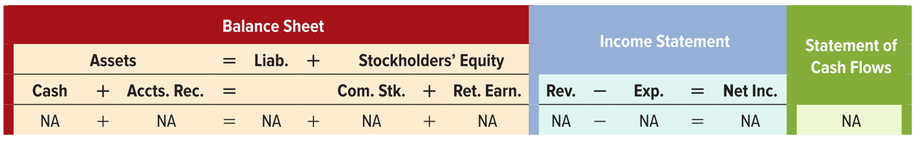
Event 6
Cato signed contracts for $42,000 of consulting services to be performed in Year 2.
Not recognized in Year 1 financial statements

Slide 10
LO 2-2:
Show how payables affect financial statements.

Slide 11
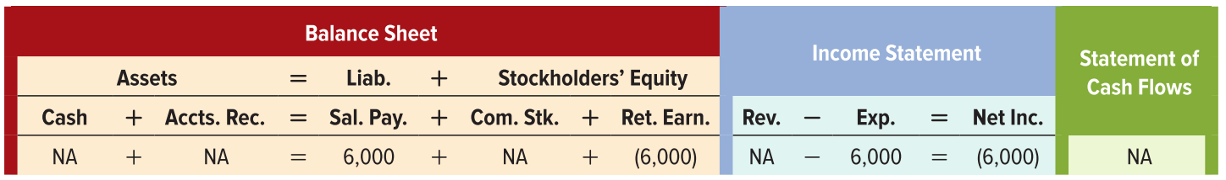
Event 7
At the end of Year 1, Cato recorded accrued salary expense of $6,000 (the salary expense is for courses the instructor taught in Year 1 that Cato will pay cash for in Year 2).
Claims Exchange Transaction

Slide 12
LO 2-3:
Prepare financial statements that include accruals.

Slide 13
Income Statement
The income statement reflects accrual accounting.
Consulting revenue represents the price charged for all services performed in Year 1, even if Cato had not received cash by the end of the year.
Expenses include all costs incurred to produce revenue, whether paid for by year-end or not.

Slide 14
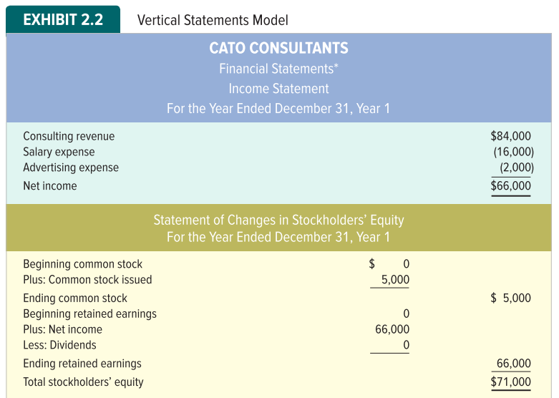
Vertical Statements Model Part 1

Slide 15
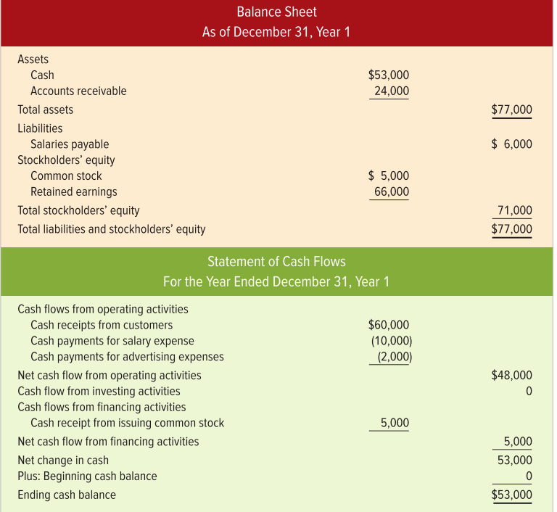
Vertical Statements Model Part 2

Slide 16
Vertical Statements Model Part 3

Slide 17
Statement of Changes in Stockholders’ Equity
Identifies how stockholders’ equity increased and decreased during the period.
The statement of changes in stockholders’ equity reports the effects on stockholders’ equity of issuing common stock, earning net income, and paying dividends to stockholders.

Slide 18
Balance Sheet
Discloses an entity’s assets, liabilities and stockholders’ equity at a particular point in time.
Cato Consultants had total assets of $77,000, which are equal to the obligations and commitments Cato has to creditors and investors.
Specifically, Cato has a $6,000 obligation to creditors with the remaining $71,000 available to support commitments to stockholders.

Slide 19
Statement of Cash Flows
Explains the change in cash from the beginning to the end of the accounting period.
In Year 1, the beginning cash balance was zero. By the end of the year, the cash balance was $53,000.
The statement of cash flows explains this increase. Cato collected $60,000 cash, paid $12,000 for expenses and acquired $5,000 cash by issuing common stock.

Slide 20
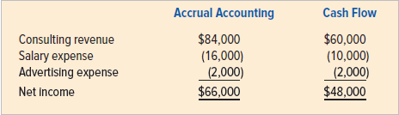
Comparing Cash Flow from Operating Activities with Net Income

Slide 21
LO 2-4:
Identify the steps in the accounting cycle.

Slide 22
Temporary and Permanent Accounts
Revenues
Assets
TemporaryAccounts
Permanent Accounts
Equity
Liabilities
Expenses
Dividends
Temporary accounts track financial results for a limited period of time.
Permanent accounts track financial results from year to year.

Slide 23
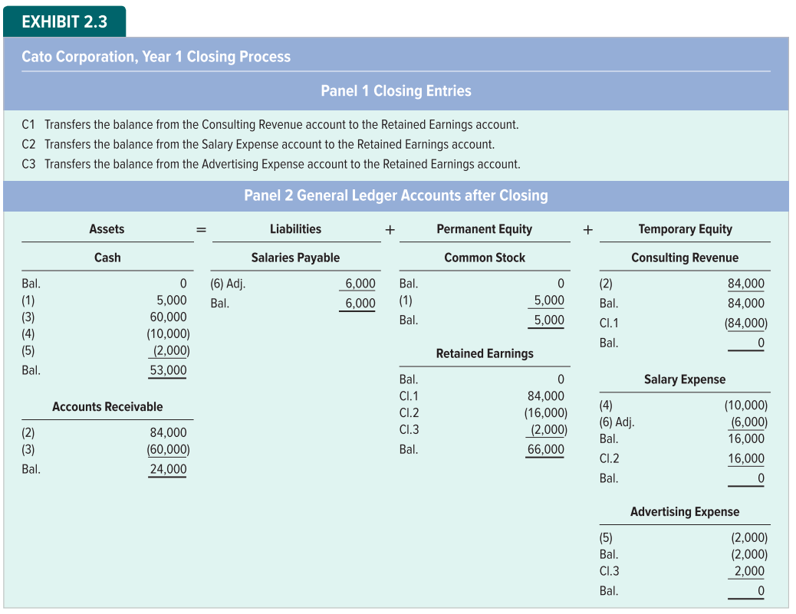
The Closing Process

Slide 24
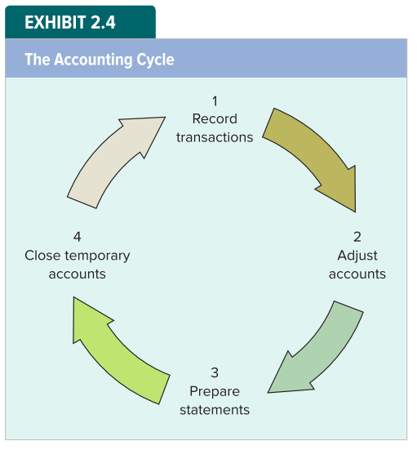
Steps in the Accounting Cycle

Slide 25
Matching Concept
Cash basis accounting can distort the measurement of net income because it sometimes fails to properly match revenues with expenses.
The problem is that cash is not always received or paid in the period when the revenue is earned or when the expense is incurred.
The objective of accrual accounting is to improve matching of revenues with expenses.

Slide 26
Section 2:
Show how deferrals affect financial statements.
Cash may be exchanged before revenue or expense is recognized. In this case the business defers recognition.

Slide 27
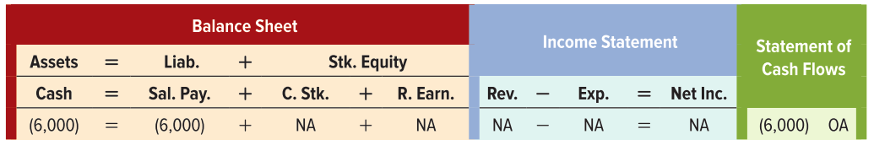
Second Accounting Cycle Event 1
Cato pays $6,000 to the instructor to settle the salaries payable obligation.
Asset Use Transaction

Slide 28
LO 2-5:
Show how accounting for supplies affects financial statements.

Slide 29
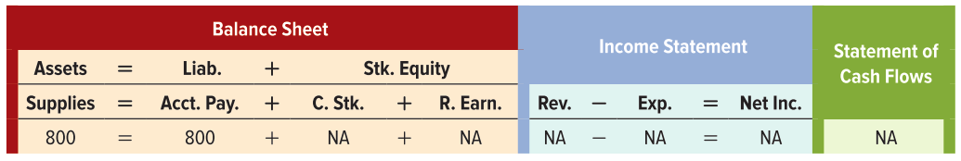
Second Accounting Cycle Event 2
Cato purchases $800 of supplies on account.
Asset Source Transaction

Slide 30
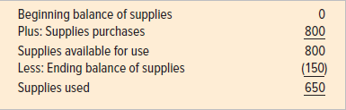
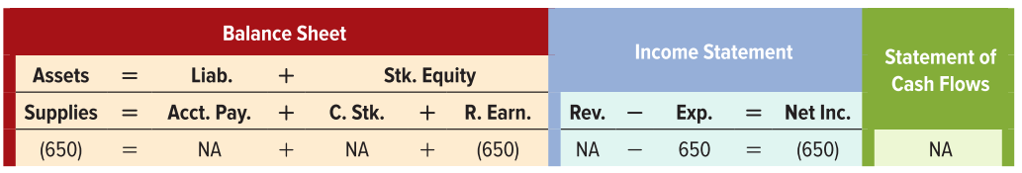
Year-End Adjustment for Supplies Adj. 1
After determining through a physical count that it has $150 of unused supplies on hand as of December 31, Cato recognizes supplies expense.

Slide 31
LO 2-6:
Show how accounting for prepaid items affects financial statements.

Slide 32
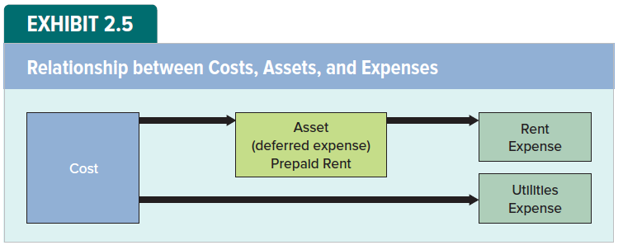
Relationship Between Costs, Assets and Expenses

Slide 33
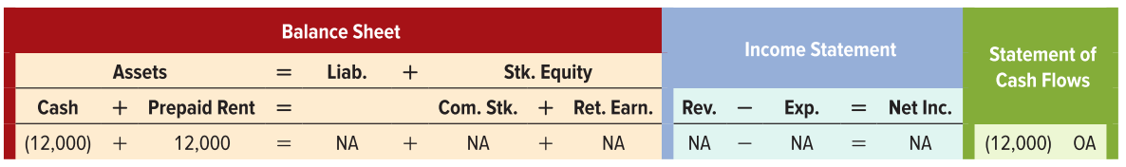
Accounting for Prepaid Items Event 3
On March 1, Cato pays $12,000 cash to lease office space for one year beginning immediately.

Slide 34

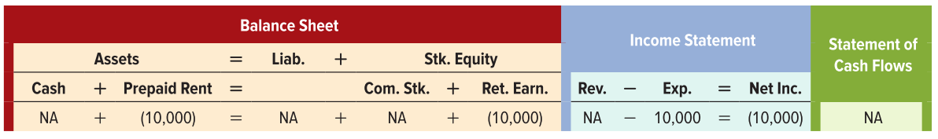
Year-End Adjustment for Prepaid Rent Adj. 2
Cato recognizes rent expense for the office space used during the Year 2 accounting period.

Slide 35
LO 2-7:
Show how accounting for unearned revenues affects financial statements.

Slide 36
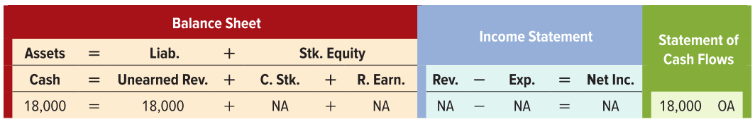
Accounting for Unearned Revenue Event 4
Cato receives $18,000 cash in advance from Westberry Company for consulting services to be performed over a one-year period beginning June 1, Year 2.
Asset Source Transaction

Slide 37

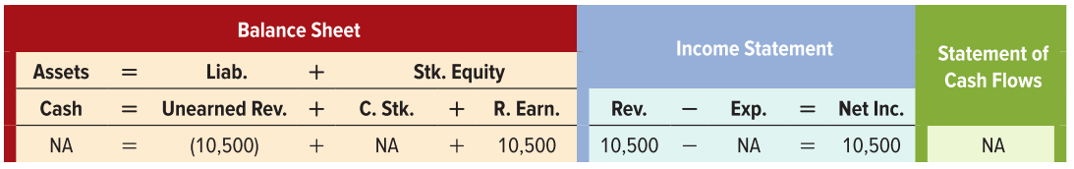
Year-End Adjustment for Unearned Revenue Adj. 3
Cato recognizes the portion of the unearned revenue it earned during the accounting period.

Slide 38
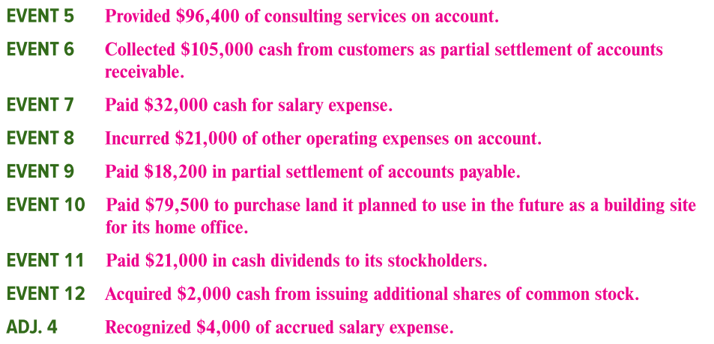
Other Year 2 Events

Slide 39
LO 2-8:
Prepare financial statements that include deferrals.

Slide 40
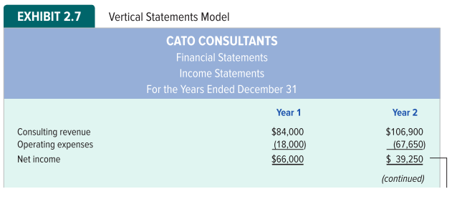
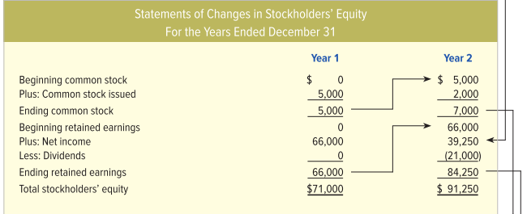
Preparing Financial Statements — Income Statement and Stockholders’ Equity

Slide 41
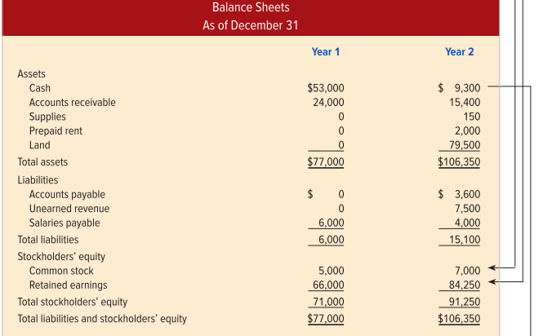
Preparing Financial Statements — Balance Sheets

Slide 42
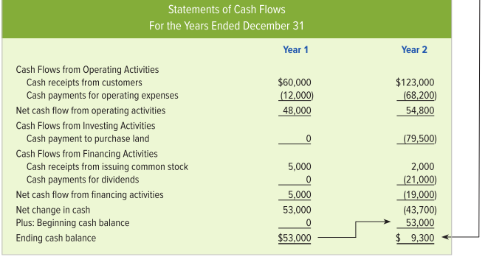
Preparing Financial Statements — Statement of Cash Flows

Slide 43
LO 2-9:
Classify accounting events into one of four categories.

Slide 44
Transaction Classification
The described transactions can be classified into one of four categories:
Asset source transactions: An asset account increases, and a corresponding claims account increases.
Asset use transactions: An asset account decreases, and a corresponding claims account decreases.
Asset exchange transactions: One asset account increases, and another asset account decreases
Claims exchange transactions: One claims account increases, and another claims account decreases

Slide 45
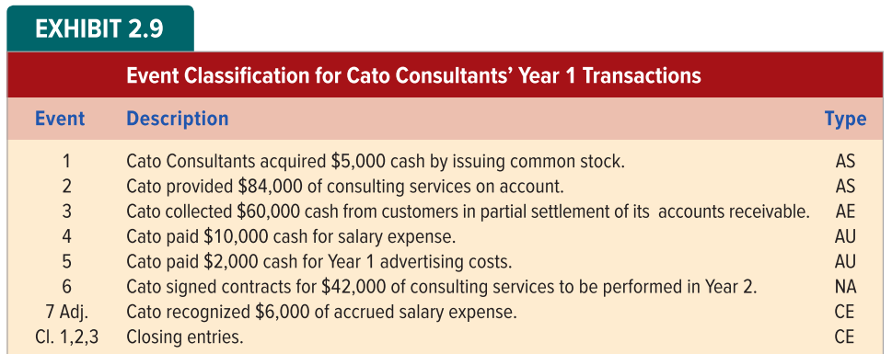
Event Classification for Year 1 Transactions

Slide 46
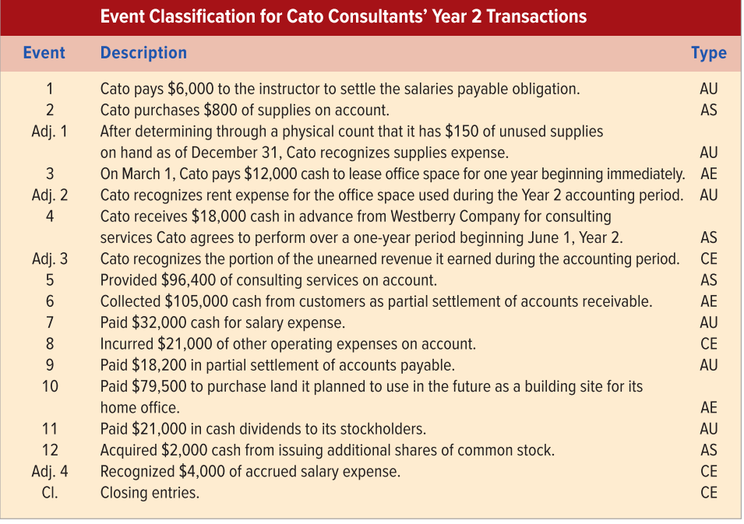
Event Classification for Year 2 Transactions

Slide 47
End of Chapter 2

